Slide 1
Arrays and Matrices
Definitions and Manipulations
Hi, I'm, an array!
0
1
2
3
4
5
SoftUni Team
Technical Trainers
Software University
https://softuni.bg

Slide 2
Table of Content
Arrays
Definition
Accessing elements
Properties and Methods
Matrices
Definition
Loop through matrix
Manipulate data

Slide 3
Have a Question?
sli.do
#JS-CORE

Slide 4

3
2
1
0
Arrays in JS
Working with Arrays of Elements

Slide 5
What is an Array?
JS arrays are used to store multiple values in a single variable
Elements are numbered from 0 to length - 1
Creating an array using an array literal
0
1
2
3
4
Element index
Array of 5 elements
… | … | … | … | …
Array element
let numbers = [10, 20, 30, 40, 50];

Slide 6
Arrays of Different Types
// Array holding numbers
let numbers = [10, 20, 30, 40, 50];
// Array holding strings
let weekDays = ['Monday', 'Tuesday', 'Wednesday',
'Thursday', 'Friday', 'Saturday', 'Sunday'];
// Array holding mixed data
var mixedArr = [20, new Date(), 'hello', {x:5, y:8}];

Slide 7
Accessing Elements
Array elements are accessed using their index number
Accessing indexes that do not exist in the array returns undefined
let cars = ['BMW', 'Audi', 'Opel'];
let firstCar = cars[0]; // BMW
let lastCar = cars[arr.length - 1]; // Opel
console.log(cars[3]); // undefined
console.log(cars[-1]); // undefined

Slide 8
Changing elements
Elements can be modified
JS arrays are resizable
Note that adding elements with high indexes can create undefined "holes" in an array!
let fruits = ['Apple', 'Kiwi'];
fruits[0] = 'Peach';
console.log(fruits); // ['Peach', 'Kiwi']
fruits.push('Banana');
fruits[fruits.length] = 'Mango';
// both examples add a new element to the array

Slide 9

Problem: Negative / Positive Numbers
You are given an array of numbers
Prepend each negative element at the front
Append each positive or zero (0) at the end
Print all elements on a new line

Slide 10
Properties and Methods
The length property returns the number of elements
The sort() method sorts the item of an array. By default, it sorts the values as strings in alphabetical and ascending order
However, if numbers are sorted as strings, "25" is bigger than "100", because "2" is bigger than "1"
let fruits = ['Mango', 'Kiwi', 'Orange'];
console.log(fruits.length); // returns 3
console.log(fruits.sort());
// ['Kiwi', 'Mango', 'Orange']

Slide 11
Sorting an array of numbers
let nums = [20, 40, 10, 30, 100, 5];
console.log(nums.join(' ')); // 20 40 10 30 100 5
nums.sort(); // Works incorrectly on arrays of numbers
console.log(nums.join('|')); // 10 100 20 30 40 5
Sorting numbers in ascending order
Sorting numbers in descending order
nums.sort((a, b) => a - b); // Compare elements as numbers
console.log(nums.join(' ')); // 5 10 20 30 40 100
nums.sort((a, b) => b - a); // Compare elements as numbers
console.log(nums.join(' ')); // 100 40 30 20 10 5

Slide 12
Add / Remove Elements at Both Ends
let nums = [10, 20, 30];
console.log(nums.join('|')); // 10|20|30
nums.push(40);
console.log(nums.join('|')); // 10|20|30|40
let tail = nums.pop(); // tail = 40
console.log(nums.join('|')); // 10|20|30
nums.unshift(0);
console.log(nums.join('|')); // 0|10|20|30
let head = nums.shift(); // head = 0
console.log(nums.join('|')); // 10|20|30

Slide 13
Problem: First and Last K numbers
You are given an array of numbers
Find first and last K numbers
Where K is the first element at the array
Print two lines:
First line must contain first K numbers
Second line must contain last K numbers

Slide 14
Slicing Arrays
let nums = ['one', 'two', 'three', 'four'];
console.log(nums.join('|')); // one|two|three|four
let firstNums = nums.slice(0, 2); // start, end+1
console.log(firstNums.join('|')); // one|two
let lastNums = nums.slice(2, 4); // start, end+1
console.log(lastNums.join('|')); // three|four
let midNums = nums.slice(1, 3); // start, end+1
console.log(midNums.join('|')); // two|three

Slide 15
Splice: Cut and Insert Array Elements
let nums = [5, 10, 15, 20, 25, 30];
console.log(nums.join('|')); // 5|10|15|20|25|30
let mid = nums.splice(2, 3); // start, delete-count
console.log(mid.join('|')); // 15|20|25
console.log(nums.join('|')); // 5|10|30
nums = [5, 10, 15, 20, 25, 30];
nums.splice(3, 2, "twenty", "twenty-five");
console.log(nums.join('|'));
// 5|10|15|twenty|twenty-five|30

Slide 16
Looping through an array
for … of works like foreach
for … in goes through array indices
Traditional for-loop
let nums = [5, 10, 15, 20, 25, 30];
for (let num of nums)
console.log(num);
for (let i in nums)
console.log(i + " " + nums[i]);
for (let i = 0; i < nums.length; i++)
console.log(nums[i]);

Slide 17

Problem: Last K Numbers Sequence
You are given two integers N and K
Generate and print the following sequence:
The first element is 1
Every next equals to the sum of the previous K elements
The length of the sequence is N elements

Slide 18
More Array Methods
includes() - check if an array contains a specific element
indexOf() - returns the position of an element in an array
isArray() - checks if an object is an array
reverse() - reverses the order of elements in an array
toString() - converts an array to string
reduce() - reduces the values of an array (from left to right)

Slide 19
Problem: Process Odd Numbers
You are given array of numbers
Find all elements in odd position
Multiply them by 2
Reverse them
Print the elements separated with a single space

Slide 20
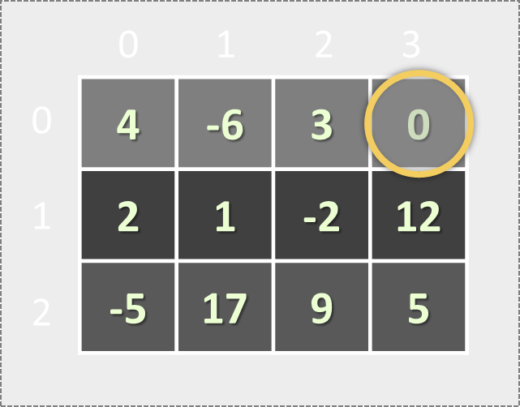
Matrices
Array of Arrays

Slide 21
Matrices in JS
A matrix is a table of values
Matrices are represented as nested arrays in JavaScript
0 1 2 3
let matrix = [
[4, -6, 3, 0],
[2, 1, -2],
[-5, 17],
[7, 3, -9, 12]
];
4 | -6 | 3 | 0
Matrix of 4 rows
0
1
2
3
2 | 1 | -2
-5 | 17
Element matrix[2][0] at row 2, column 0
7 | 3 | -9 | 12

Slide 22
Looping through a matrix
let matrix = [[4, 5, 6],
[6, 5, 4],
[5, 5, 5]];
for (let row = 0; row < matrix.length; row++) {
console.log(matrix[row]);
for (let col = 0; col < matrix[row].length; col++) {
console.log(matrix[row][col]);
}
}
Prints each row of the matrix on a separate line
Prints each element of the matrix on a separate line

Slide 23

Live Exercises

Slide 24

Summary
Arrays are used to store multiple values in a single variable
Elements are accessed using their index number
Sorting and modifying elements using methods
Looping through arrays with for … of, for … in and traditional for-loop
A matrix is a table of values
…
…
…

Slide 25
https://softuni.bg/courses/js-essentials

Slide 26












SoftUni Diamond Partners

Slide 27




SoftUni Organizational Partners

Slide 28




Trainings @ Software University (SoftUni)
Software University – High-Quality Education and Employment Opportunities
softuni.bg
Software University Foundation
http://softuni.foundation/
Software University @ Facebook
facebook.com/SoftwareUniversity
Software University Forums
forum.softuni.bg

Slide 29

License
This course (slides, examples, demos, videos, homework, etc.) is licensed under the "Creative Commons Attribution-NonCommercial-ShareAlike 4.0 International" license

